Slide 1
Image Classification Using CNN
Team Members
Sama Hesham Sayed Hussein Ibrahim Hassan
Rana Hamdy Abdelkader Marwan Ahmed Mohamed
Riham Mohsen Sayed Ahmed Hamdy Abdel Sattar

Slide 2
Introduction:
Image classification is used to classify images from datasets according to their category. Image classification can be done by many means and ways. From these ways in ANN is used to observe some patterns in the datasets and using ANN for this purpose would end up being very costly in terms of computation since the trainable parameters become extremely large. And in this case using CNN would be better.
For example, if we have a 50 X 50 image of a cat, and we want to train our traditional ANN on that image to classify it into a dog or a cat the trainable parameters become – (50*50) * 100 image pixels multiplied by hidden layer + 100 bias + 2 * 100 output neurons + 2 bias = 2,50,302.
Convolutional Neural Networks (CNN) come under the subdomain of Machine Learning which is Deep Learning. Algorithms under Deep Learning process information the same way the human brain does, but obviously on a very small scale, since our brain is too complex (our brain has around 86 billion neurons).The Convolutional Neural Network (CNN) is a subtype of Neural Networks that is mainly used for applications in image and speech recognition. Its built-in convolutional layer reduces the high dimensionality of images without losing its information. That is why CNNs are especially suited for this use case. We use filters when using CNNs. Filters exist of many different types according to their purpose.

Slide 3
Dataset:
Out dataset is divided into two parts one for the training and one for testing
The training data is 14,034 image categorized into 6 categories :
street: 2,382 image.
sea: 2,274 image.
mountain: 2,512 image.
buildings: 2,191 image.
forest: 2,271 image.
glacier: 2,404 image.

Slide 4
The testing data is 3,000 also categorized into 6 categories:
street: 501 image.
sea: 510 image.
mountain: 525 image.
buildings: 437 image.
forest: 474 image.
glacier: 553 image.
The source of the data Kaggle.com link :
(“ https://www.kaggle.com/datasets/puneet6060/intel-image-classification”)

Slide 5
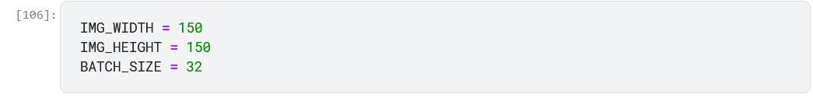
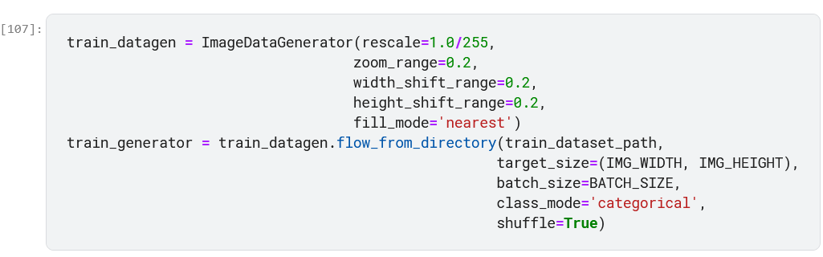
Data preprocessing:
Data preprocessing involves assigning the paths of the folders and resizing the images.
Then loading the training dataset and apply argumentations to it.

Slide 6
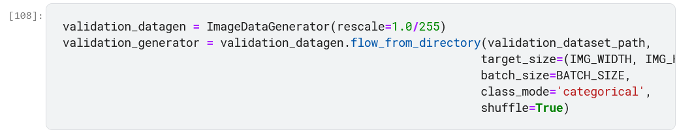
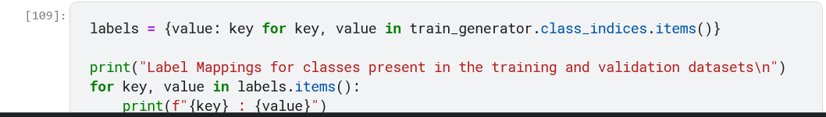
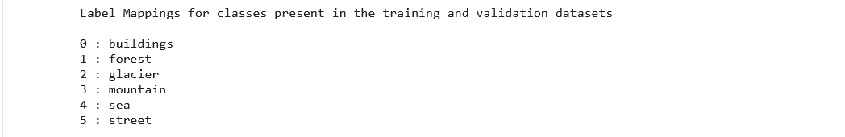
Loading validation dataset and apply argumentations to it.
Assigning labels to the data.

Slide 7
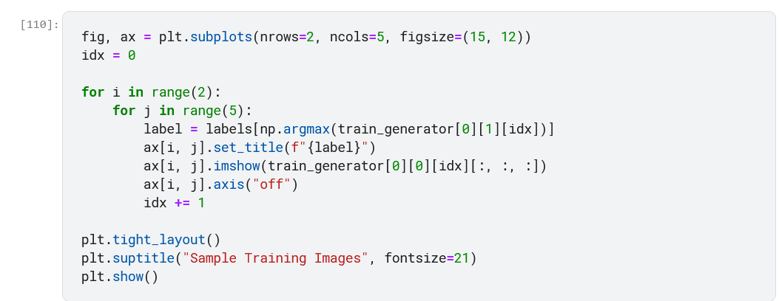
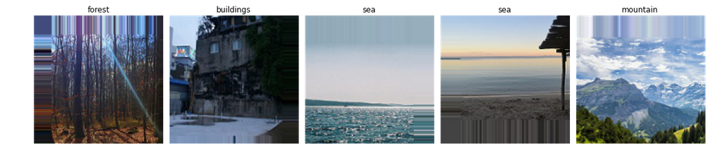
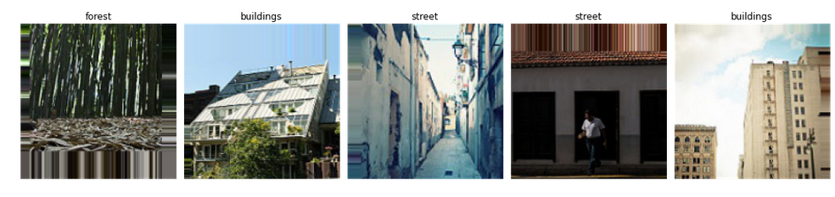
Plot some of the training data.

Slide 8
Defining and compiling the training model :
We first initialize a sequential model then add the layers in it , Conv2D is used to apply filters , kernel , activation, and padding:
Filters: The primary purpose of convolution is to find features in the image using a feature detector. Then put them into a feature map, which preserves distinct features of images, and it’s initialized randomly , then after a lot of iteration, filter matrix parameter selected which will be best for separating images.
Kernel_size: Kernel_size refers to filter matrix size.
Padding : Padding is a simple process of adding pexels with 0 or -1 to input images .
Activation function: Since images are non-linear, to bring non-linearity, the Relu activation function is applied after the convolutional operation. Relu function will output the input directly if it is positive, otherwise, it will output zero.

Slide 9
Pooling function :
We need to apply the pooling operation after initializing CNN. Pooling is an operation of down sampling of the image. The pooling layer is used to reduce the dimensions of the feature maps. Thus, the Pooling layer reduces the number of parameters to learn and reduces computation in the neural network.
Flatten operation:
Flattening operation is converting the dataset into a 1-D array for input into the next layer which is the fully connected layer.
Dense operation :
Is used to create a fully connected layer and output layer, the last one is Softmax function .It is used as the last activation function of a neural network to bring the output of the neural network to a probability distribution over predicting classes. The output of Softmax is in probabilities of each possible outcome for predicting class. The probabilities sum should be one for all possible predicting classes.

Slide 10
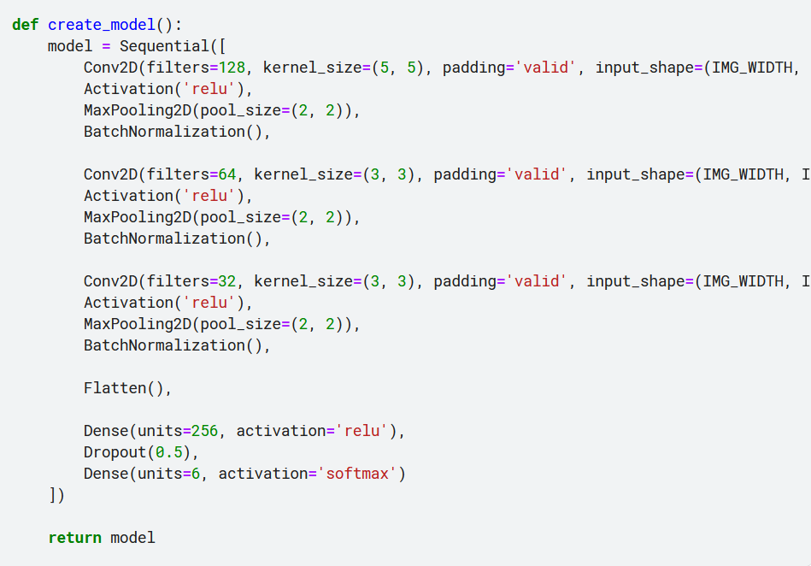
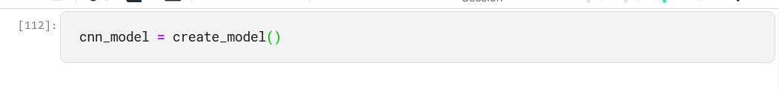

Slide 11
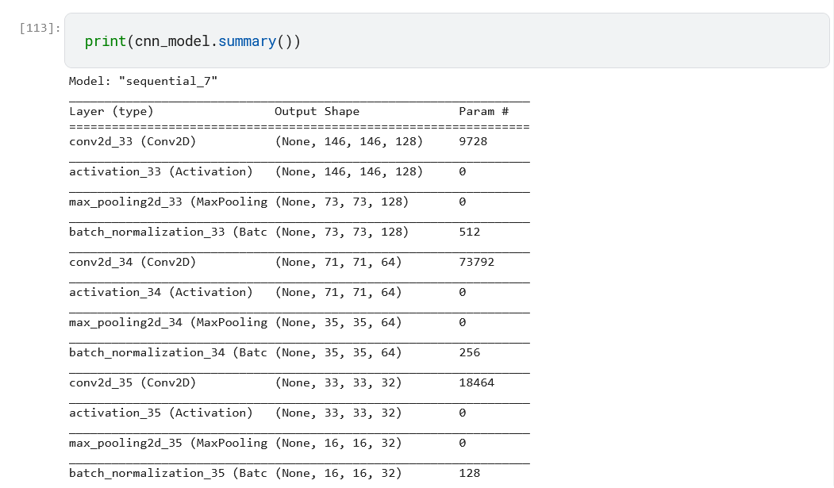
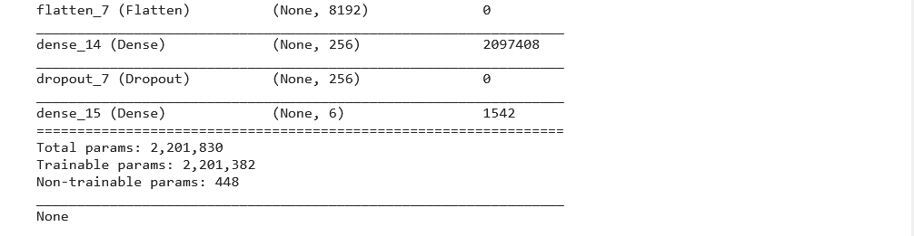

Slide 12
Compile model :
Loss function : We are using the “categorical_crossentropy” loss function that is used in the classification task. This loss is a very good measure of how distinguishable two discrete probability distributions are from each other.
Optimizer : We are using “Adam” Optimizer that is used to update neural network weights and learning rate. Optimizers are used to solve optimization problems by minimizing the function.
Metrics arguments : Here, we are using Accuracy as a metrics to evaluate the performance of the Convolutional neural network algorithm.

Slide 13
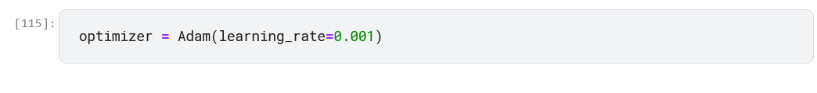
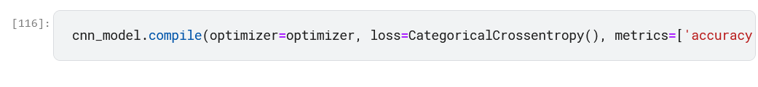
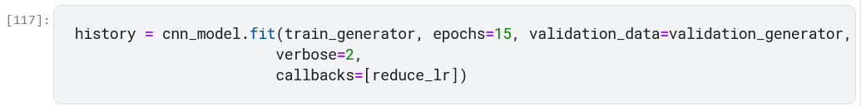
Fit model on training set:
We are fitting the CNN model on the training dataset with 15 iterations and each iteration has different steps for training and evaluating steps based on the length of the test and training set.

Slide 14
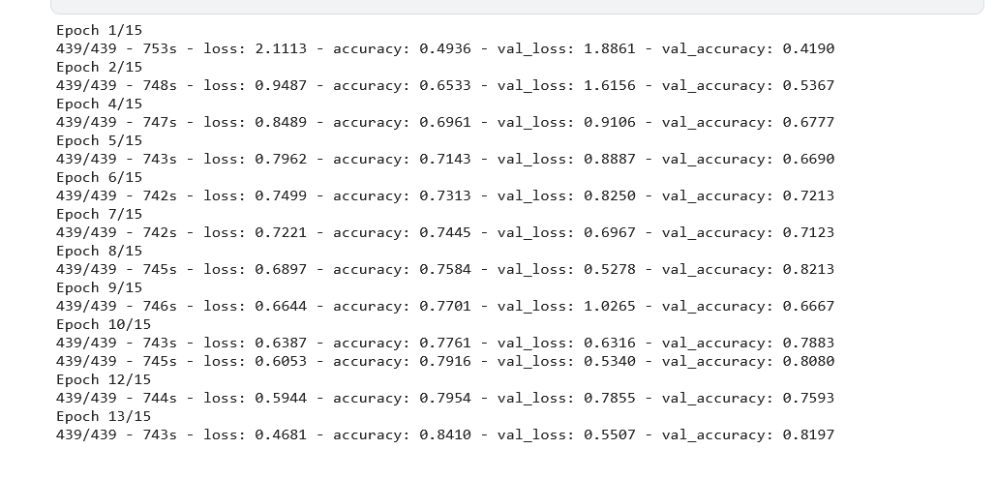
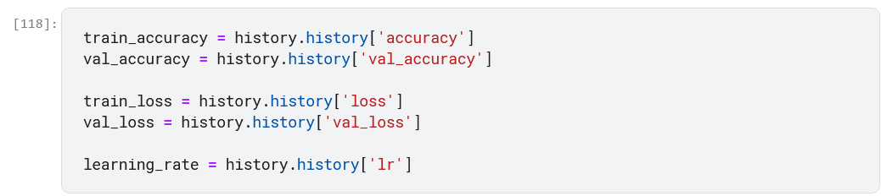
Evaluate Result:
We compare the accuracy and the val_accuracy ,and loss and loss_val.

Slide 15
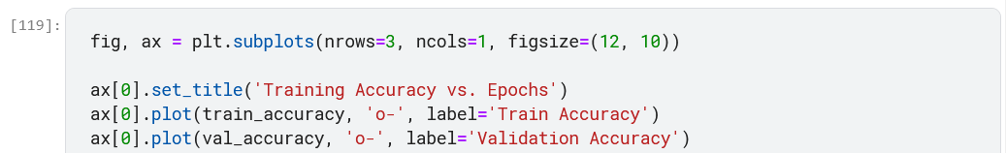
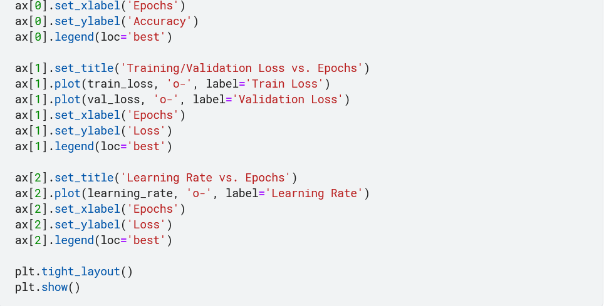
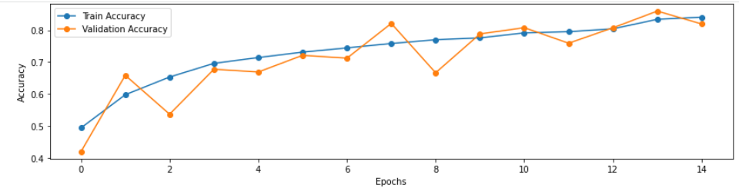

Slide 16
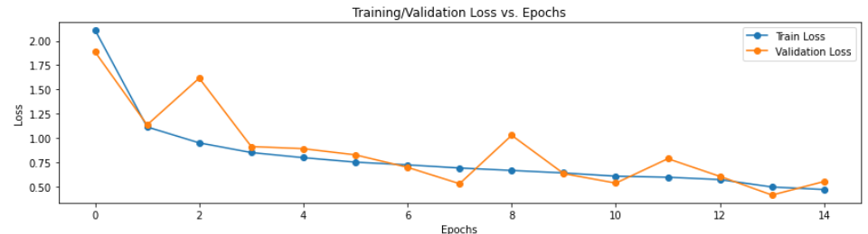
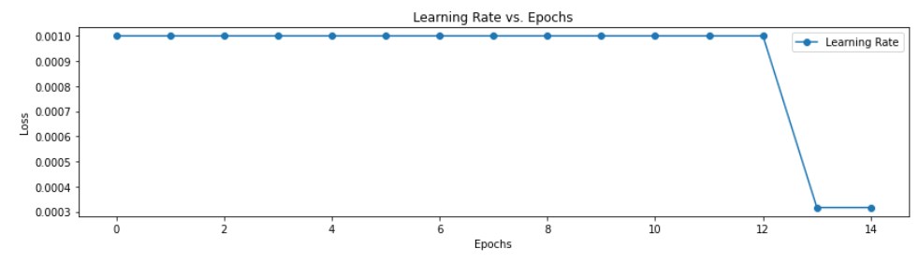
Plot of learning rate according to epochs :

Slide 17
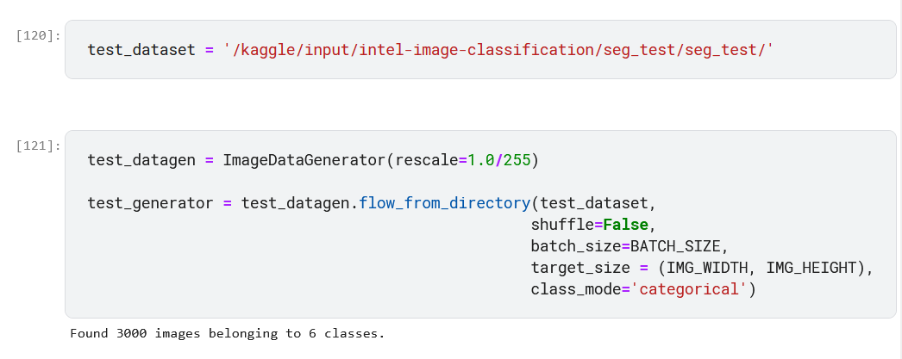
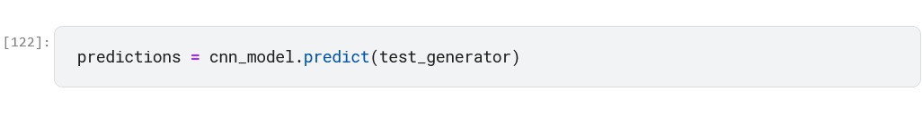
Loading the test dataset:
Assigning predictions:

Slide 18
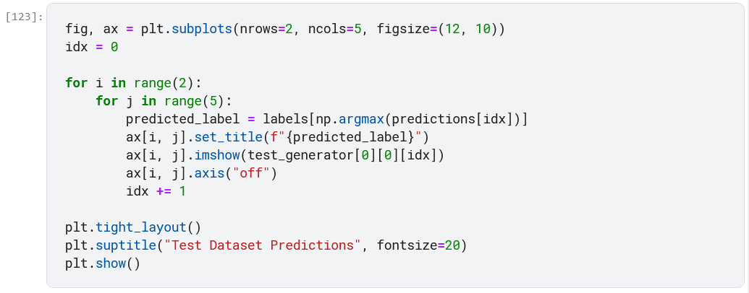
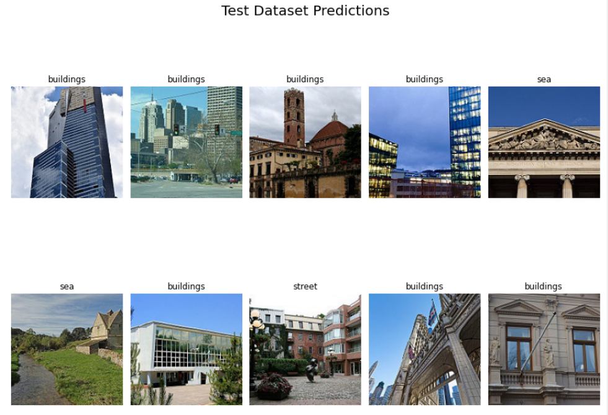
Plot test predictions:

Slide 19
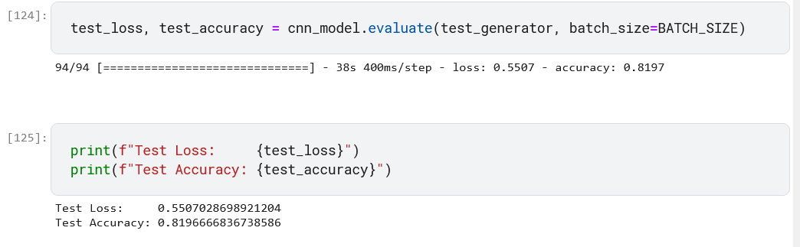
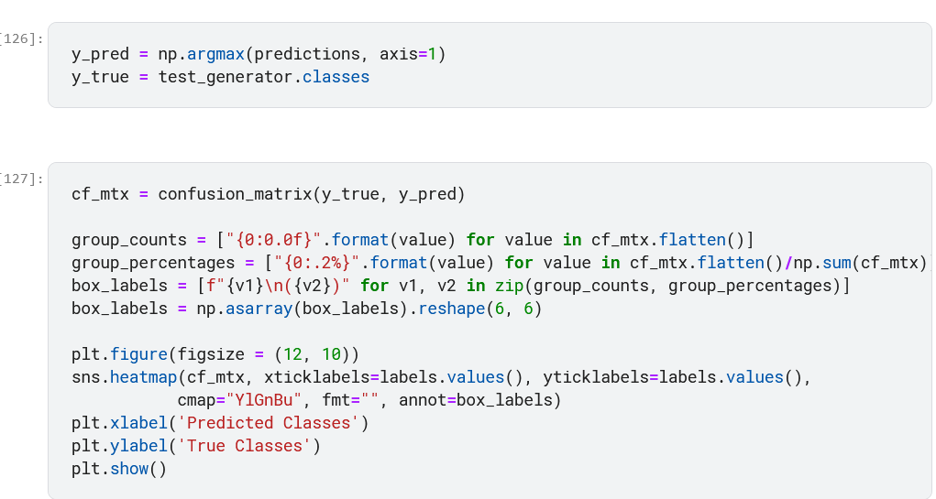
Plotting the confusion matrix for the data :

Slide 20
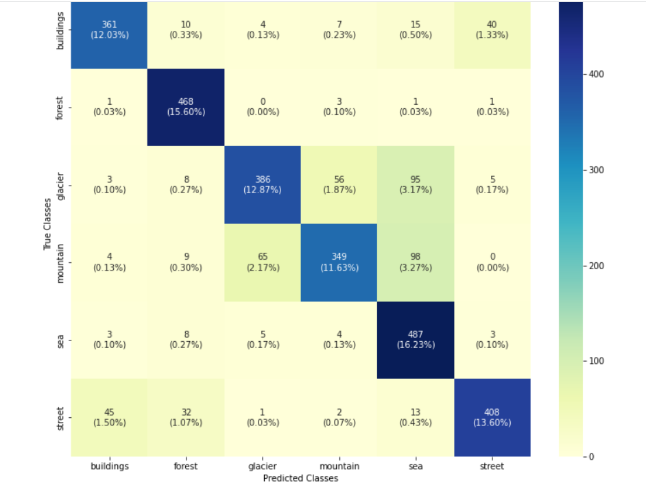
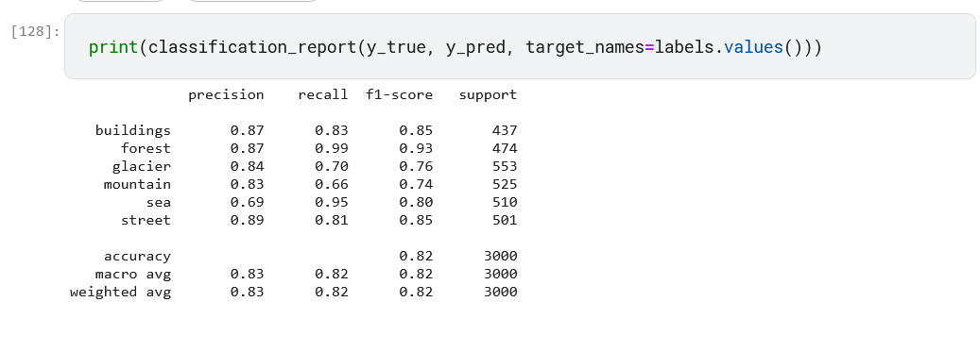
Printing classification report with precision ,recall and accuracy:

Slide 21
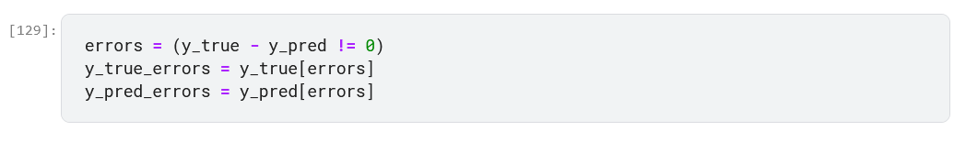
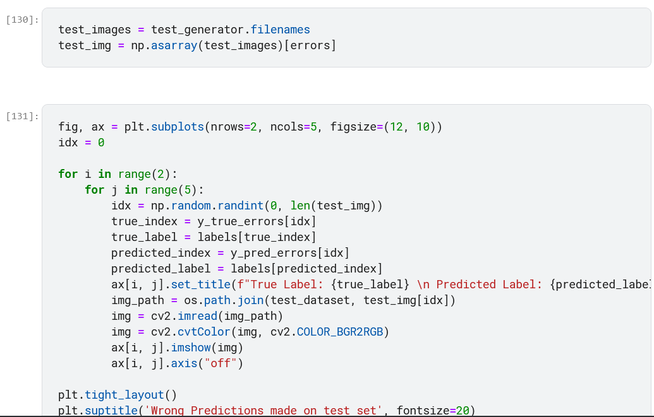
Plotting the wrong predictions in the test data :

Slide 22
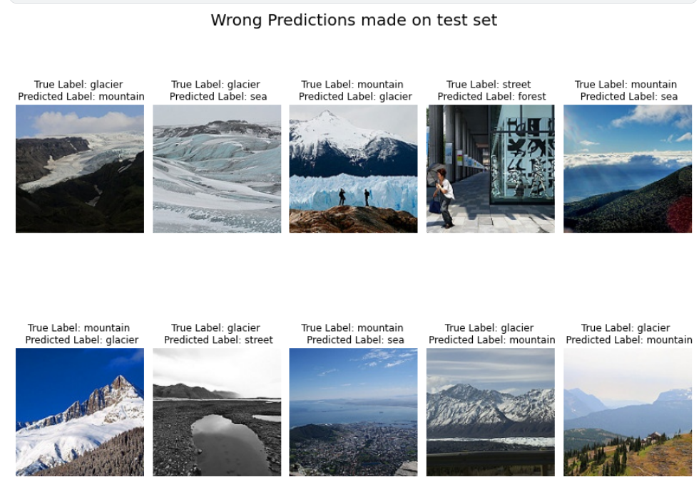

Slide 23
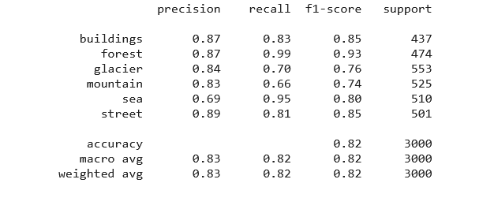
Results of classification prediction:
Conclusion :

Slide 24
The accuracy in the training data is near from the accuracy of testing data.
The loss decreases together this means that the model is good fit .

Slide 25
Source Code

Slide 26
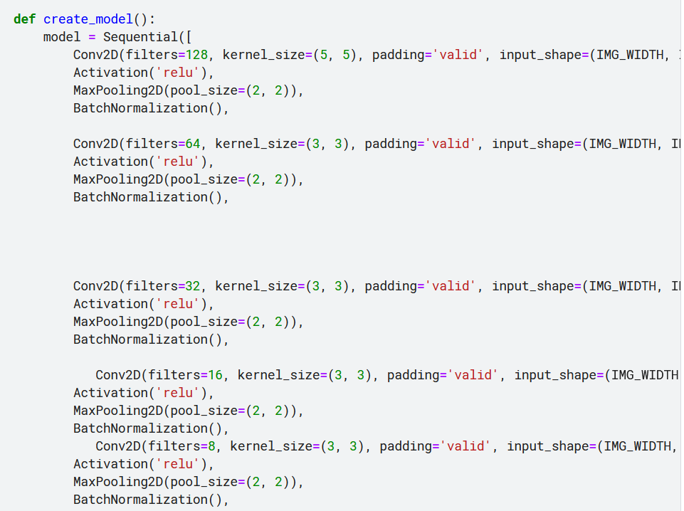
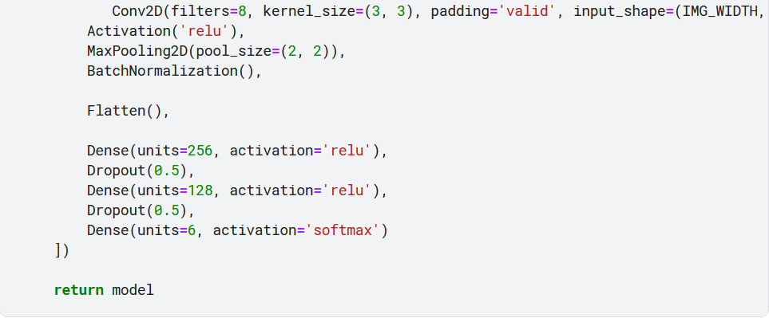

Slide 27
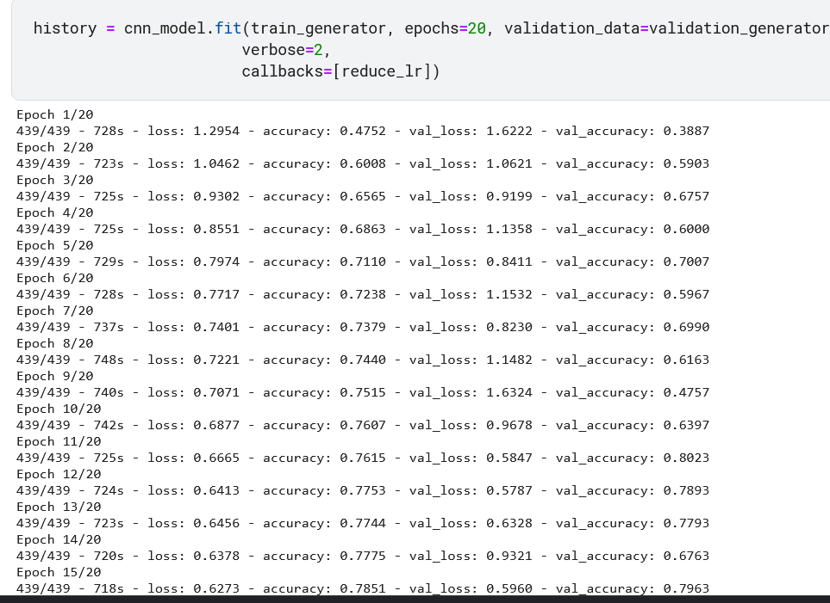
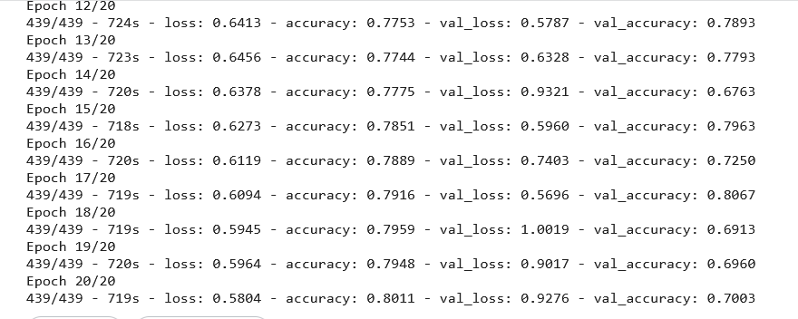

Slide 28
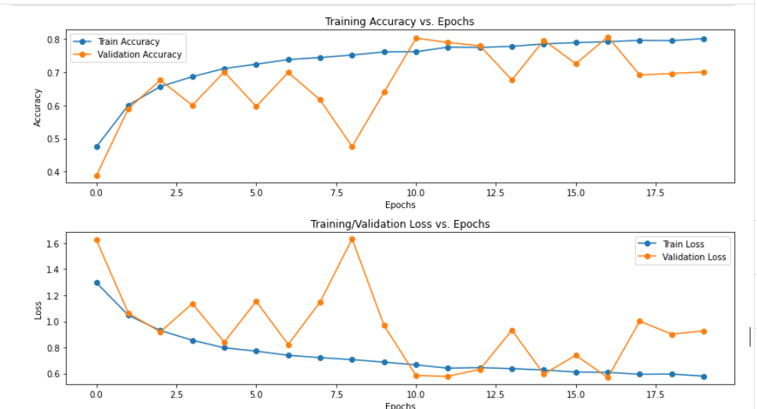

Slide 29
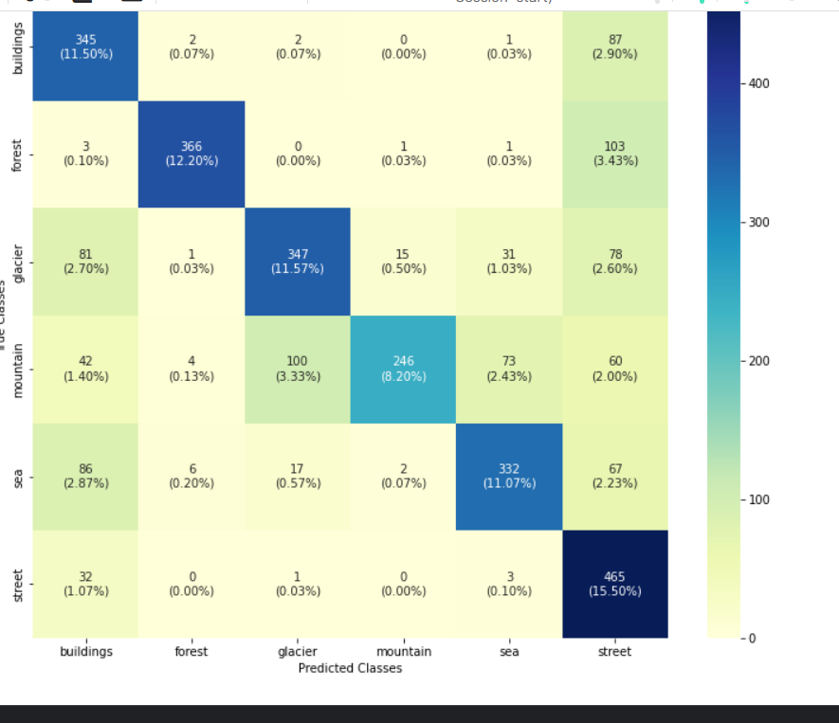
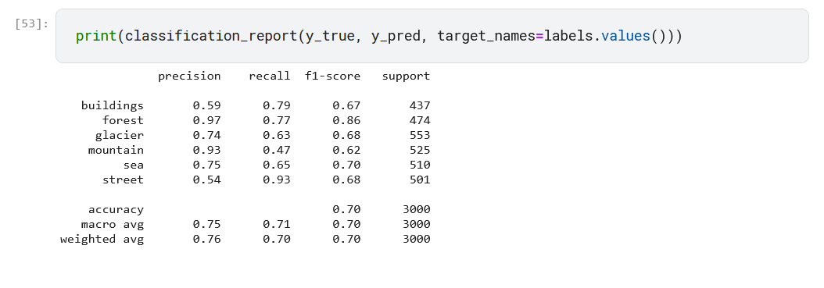

Slide 31
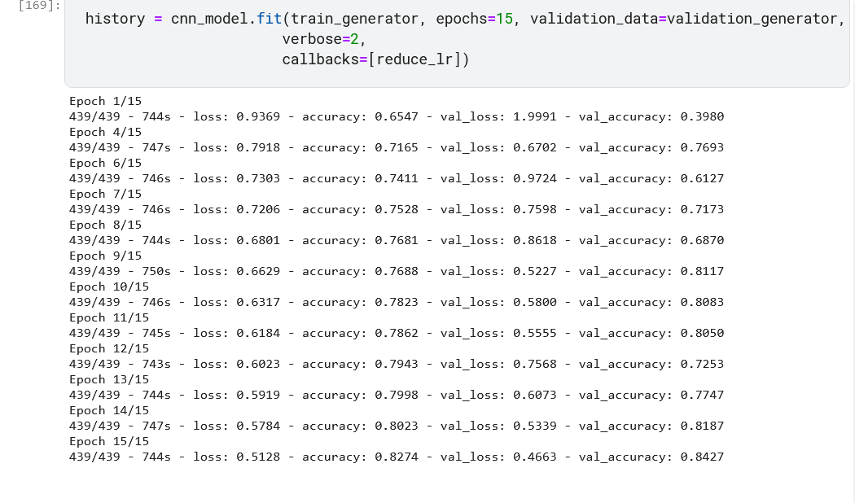
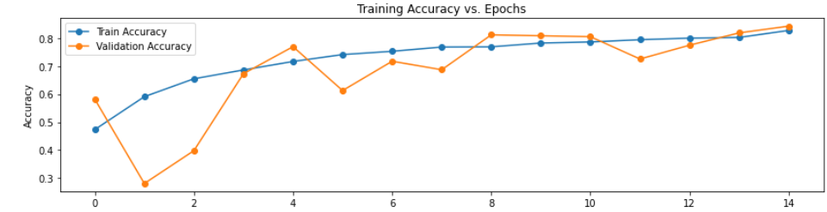

Slide 32
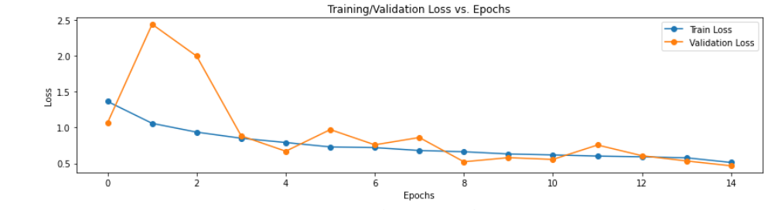
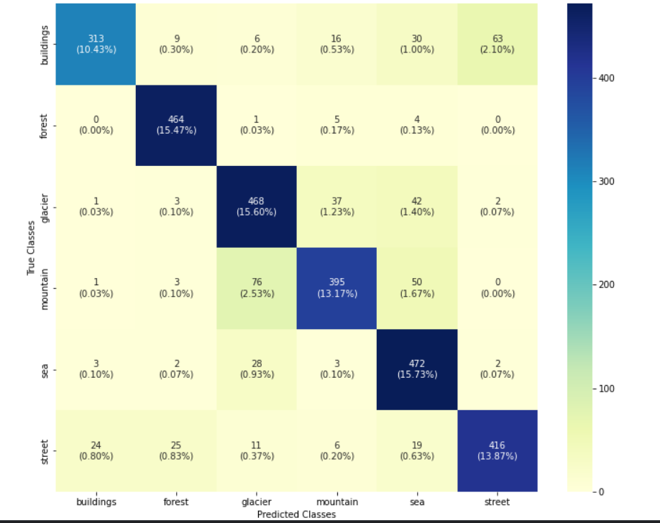

Slide 33
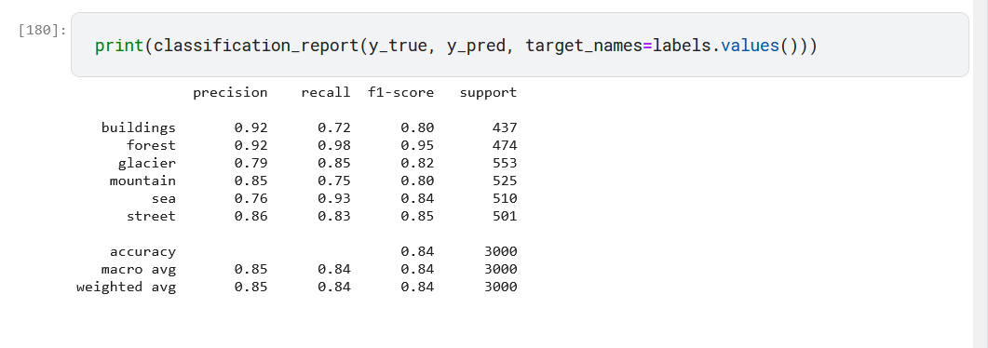

Slide 34
Thank You

